Slide 1
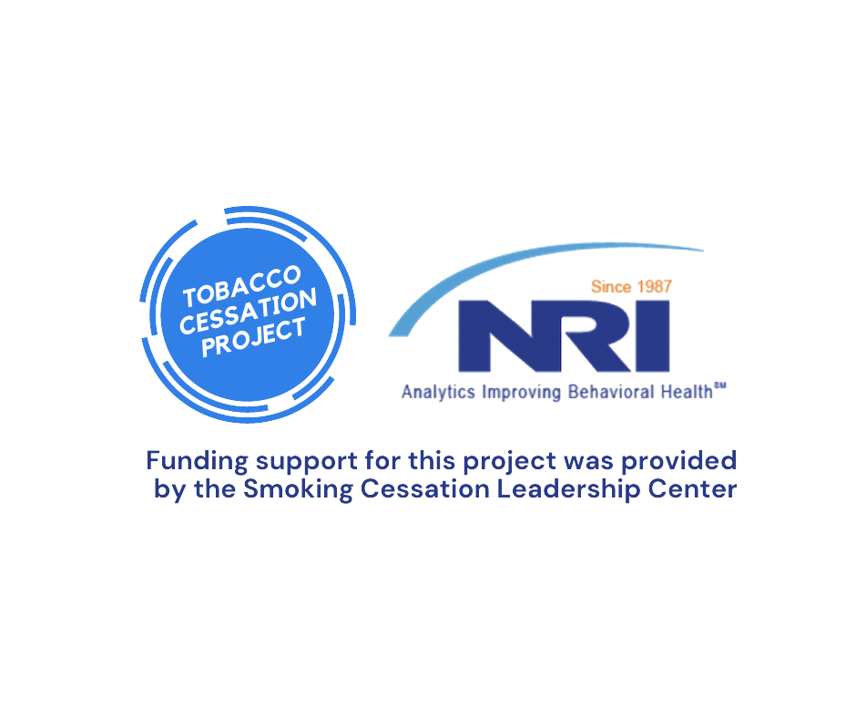
Today’s presentation is part of a NRI series focused on improving access to tobacco cessation recovery for persons in psychiatric hospitals.
Complete the Pre-test to establish your baseline knowledge now. Cut and paste link to new window: https://wh1.snapsurveys.com/s.asp?k=160554894320
Notes:
thanks for completing pre-test: not scored but assists NRI with future QI and training needs Inpatient psychiatric settings have been
making strides in quickly identifying tobacco users at the point of admission and providing treatment to
support recovery from tobacco use. But this momentum is not continuing through the point of discharge
planning to ongoing recovery self-management for persons served by inpatient psychiatric settings.

Slide 2

Tobacco Cessation: Improvement Strategies for Inpatient Psychiatric Facilities
Missy Rand, LPC, CSAC
Lucille Schacht, PhD, CPHQ
Glorimar Ortiz, PhD
Heath H. Hayes, MA, MHR, CPRSS
November 18, 2020
Notes:
Welcome, thanks for completing pre-test: not scored but assists NRI with future QI and training needs . Post-test at the end for impact of this session

Slide 3
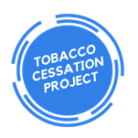

Missy Rand, LPC, CSAC
NRI Clinical Quality Educator
Missy.Rand@nri-inc.org
703.738.8172
Notes:
Review and reference to Sept. webinar thanks for completing pre-test: not scored but assists NRI with future QI and training needs

Slide 4
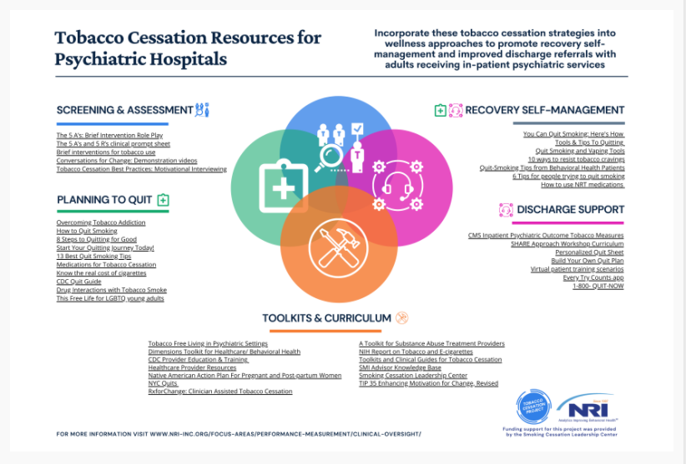
Tobacco Cessation Project
https://www.nri-inc.org/focus-areas/performance-measurement/clinical-oversight/tobacco-cessation/clinical-action/
Notes:
Rate of tob smokers higher in Beh health pops and account for about ½ all smoking deaths annually for all Americans. We focused on the clinical impacts in Sept. 2020 and info here at website

Slide 5

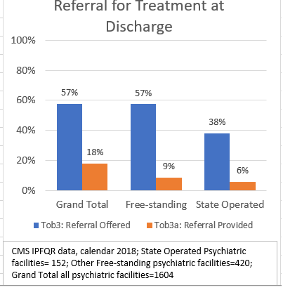
CMS Tobacco Measures:
TOB 3 and 3A
Notes:
Although screening for tobacco use at admission to inpatient psych hospitals is now expected practice, , state hospitalsTOB-3 is the rate of referrals being offered to patients while TOB-3A is the rate of patients
accepting those referrals.

Slide 6
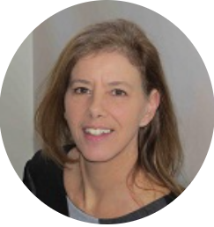
Lucille Schacht, PhD, CPHQ
NRI Senior Director, Performance & Quality Improvement
Lucille.Schacht@nri-inc.org
703.738.8163
Notes:
Transition from individual change to organizational change applications

Slide 7
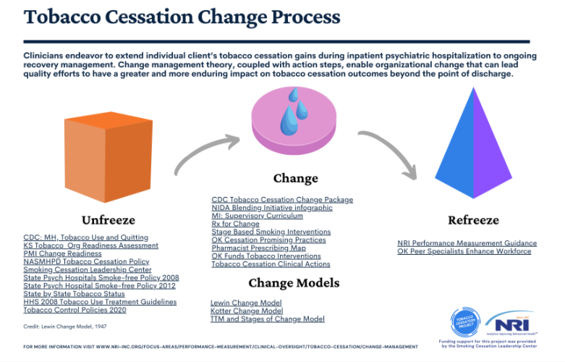
Lewin’s change Model
Notes:
https://www.nri-inc.org/media/1685/stages-of-change.pdf

Slide 8
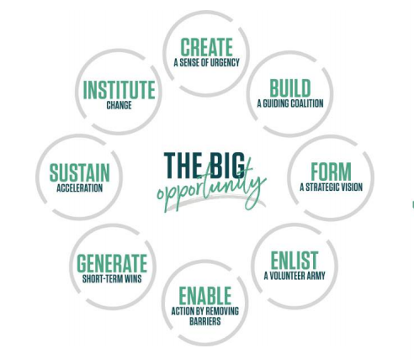
Organizational Change
John Kotter Change Process. https://www.kotterinc.com/8-steps-process-for-leading-change/
Notes:
John Kotter Change Process. https://www.kotterinc.com/8-steps-process-for-leading-change/

Slide 9
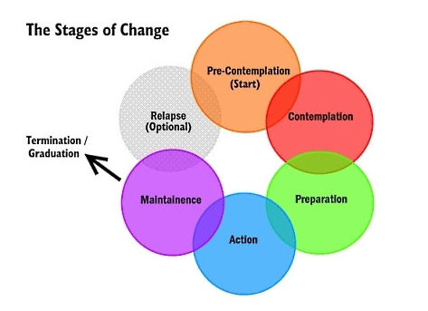
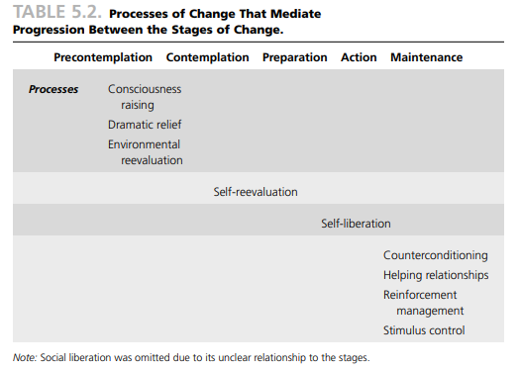
Individual Behavior Change
Prochaska, DiClemente, Norcross, Stages of Change and the Transtheoretical Model (TTM)
http://thehubedu-production.s3.amazonaws.com/uploads/3/18722973-f80f-4b55-8ffe-fafa44c21979/health_education.pdf#page=135
Notes:
One of several change models available, This is one clinicians are familiar with.

Slide 10
Leadership
Establishing vision
  Clear vision of the future AND strategies for producing needed changes
  Providing the “why now” case and defining why “status quo is not good enough”
  Connecting new behaviors with organizational success
  Dealing directly with resistance
Aligning people
  Communicating direction in words and deeds
  Inclusive of all staff who need to be “on-board” with new vision, especially people with power (title, SME, relationships)
  Creating teams/coalitions that agree with the validity of the vision – serve as role models for other staff
Motivating and inspiring
  Encourage outside-the-box thinking and approaches
  Energizing staff to overcome barriers to change
  Removing obstacles (outdated policies/procedures)
  Reinforcing/acknowledging basic human needs (rewards, recognition, respect)
Notes:
Additional Talking points: Vision

Slide 11

Unfreeze Tob 3/3a
Education
Action
“You cannot understand a system until you try to change it.” ~Kurt Lewin
3 components should be present in the organization: dissatisfaction with current TOB-3 outcomes, risk tolerance to try a new approach, provision of organizational safety by leadership to permit facile change
What are the current forces that maintainTOB-3 outcomes as they currently exist?
What are the imperatives for change?
“Action research” tracks the potential impact of any change intervention
The more transparent and inclusive the process is, the more readily people move through the unfreezing stage
Assess organizational change readiness
Review TOB measure definitions
Research the issue for benchmarking and decision-making including TOB measure control chart data
Leadership must demonstrate high-level enthusiasm, clinical support and partnership with technology capacity
Form a diverse team to oversee the project including client voice
Create a clear aim and timetable
Gain staff/ client commitment through effective communication
Align your plan with tobacco screening cessation protocol, treatment process flow to discharge, IT interface, measure outcomes, and rewards for practice change
Notes:
Kurt Lewin’s Change Management Theory, is a time-tested, easily applied field theory that is often considered the epitome of change models, suitable for personal, group and organizational change. Lewin’s change theory is a ‘planned change’ guide that consists of three distinct and vital stages. The first stage involves finding a method of making it possible for people to let go of an old pattern that was counterproductive in some way. This is the stage where the desire to change occurs, or at least the recognition that change is needed. An example is moving from a paper- based documentation system to an electronic system, in an organization where paper trails have become unmanageable and archaic.
Reference Lucille Schacht’s NRI Self-assessment tool template to monitor performance on targeted measures

Slide 12
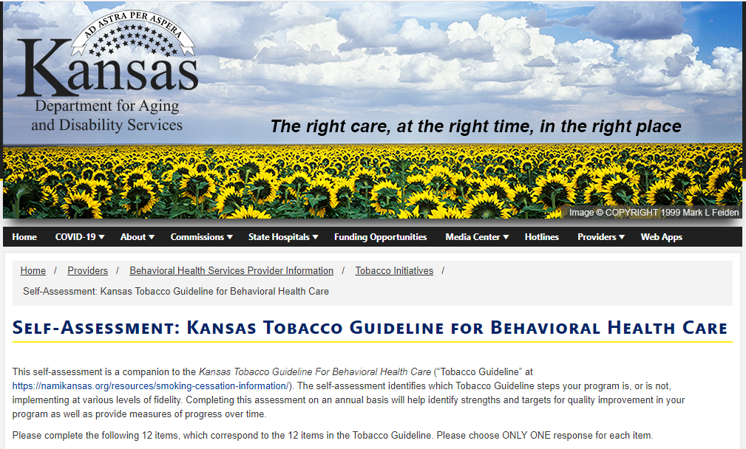
https://kdads.ks.gov/provider-home/providers/behavioral-health-tobacco-initiatives/self-assessment-kansas-tobacco-guideline-for-behavioral-health-care
Notes:
Action: organizational readiness to change.

Slide 13
The Georgia Experience
What evidence did you provide to the clinical/peer provider workforce to engage them in the change effort (scientific evidence, survey results (BRFFS)?
CDC estimates smoking rates among individuals with psychiatric disorders to be 2-4 times higher than the general US population.
The 2015 Behavior Risk Factor Surveillance Survey (BRFSS) in Georgia, 37.3% of adults who reported frequent mental distress were current smokers, and approximately 66.6% of these individuals want to quit.
Evidence shows that implementing the US Public Health Service (USPHS) 5 A’s (Ask, Advise, Assess, Assist, Arrange) in treating tobacco dependence is effective.

Slide 14

Staff Needs and Organizational Barriers to Providing Active Treatment and Referral for Tobacco Cessation: Survey Results
Glorimar Ortiz, PhD
NRI Principal Biostatistician
Glorimar.Ortiz@nri-inc.org
703.738.8168

Slide 15
NRI Facility Tobacco Survey 2020
To investigate staff needs and organizational barriers to:
1 - offer active treatment for tobacco cessation
2 - refer patients for tobacco cessation treatment after discharge
Survey period: July 21 – August 21, 2020
165 facilities surveyed
108 surveys received
70 facilities responded
42% response rate

Slide 16
Resources
Educational & training materials:
success stories, coping skills, how addictive nicotine is, pharmacotherapy and interaction with psychiatric disorders and their treatment, evidenced-based tobacco use cessation programs, treatment intervention templates, training about change in staff behavior and attitude towards tobacco use
Time
Human:
certified staff, tobacco cessation counselors, substance use disorder specialists
What did staff say they need to offer active treatment for tobacco cessation?

Slide 17
What did staff say are organizational barriers to offering active treatment for tobacco cessation?
Lack of funds
Frail tobacco use cessation culture
Shortages of trained/certified staff
Tobacco use cessation treatment is not a priority
Limited time dedicated for active treatment and counseling services
Tobacco use cessation is not taken seriously
Scarce tobacco use cessation resources
Physicians are reluctant to prescribe medication for tobacco cessation
Decreased pharmacotherapy/
medication options
Inappropriate use of some medications

Slide 18
What did staff say they need to refer patients for tobacco cessation treatment after discharge?
Information
Consistent patient contact information
List of outpatient programs available with contact information
Training
On evidence-based pharmacological interventions
About requirements for treatment at discharge
Partnership
Active relationship with personnel at the tobacco cessation treatment centers
Improve direction from physicians
List of community resources for patients to use at discharge
Related to specialized treatment programs

Slide 19
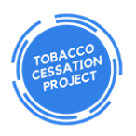
What did staff say are organizational barriers to referring patients for tobacco cessation treatment after discharge?
Patient Level
In-patient Level
Out-patient Level
* (Perceived) Resistance to quit
* (Perceived) Lack of interest/motivation
*No reliable contact information at discharge
*Confidentiality issues: unable to refer
*Staff: Not trained/enough staff
*Time: Not enough time to make referrals
*Costs: Not enough funds to cover required training costs
*No or limited community resources
*Scarce specialized treatments for tobacco cessation
*Lack of appropriate programs
*Quitlines are not interactive
Notes:
Transition back to missy to discuss next phase of Lewin’s change model

Slide 20

Change TOB 3/3A
Education
Action
Identify specific change(s) and make the “Why Now” case
Process of changing thoughts/feelings/behavior of staff and systems
Persuasion that new way is better
Time consuming, costly, and productive stage
Implementation of new processes and structures
Use engaging communication and training support to motivate hearts/minds/actions
Plot change tasks
Engage and empower “champions”
Small PDSA cycles, then expand to wider implementation
Eliminate access to “old” way
Monitor TOB outcome measures for change impact
Notes:
You’ve looked at your baselines, gap analysis, standards, options for change in previous phase of Unfreeze. This phase is disciplined and involved lots of PDSA cycles, make sure all staff are onboard with new way of implementing vision/ AIM, smooth out the process based on feedback loops

Slide 21
The Illinois Experience
Electronic Discharge Plan
TOB 3 Retrain
Quitline Added
Notes:
IL05: Aug – Dec. 2018 had training for clinical staff to learn new electronic discharge plan application. Intended primary aim was use of electronic discharge plan, but embedded QUITLINE offering in our database as a part of the discharge summary, which is addressed by Social Workers and Psychiatrist. Getting rid of all old paper forms helps to continue this change of TOB 3 improvement.

Slide 22
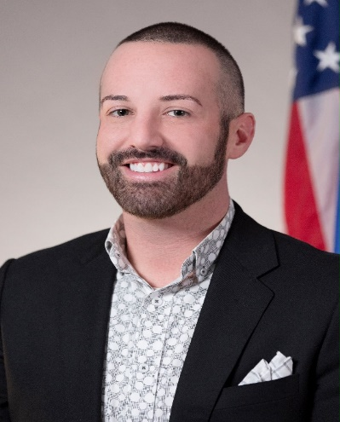
The Oklahoma Experience
Heath Hayes, MA | OK Dept of Mental Health & Substance Abuse Services
Senior Director of Communications and Strategic Engagement | Cell: 405.315.2079
Heath.Hayes@odmhsas.org
Notes:
2020: Oklahoma has the highest proportion of behavioral health treatment agencies in the nation that offer cessation interventions such as state quitlines, prescribe cessation medications and provide tobacco-free campuses.

Slide 23


A Culture of Wellness:
Lived Experience with Tobacco Cessation within Mental Health Systems
Heath Hayes, M.A., M.H.R., C.P.R.S.S.
Oklahoma Department of Mental Health and Substance Abuse Services Senior Director - Strategic Communications & Engagement

Slide 24

ODMHSAS: What We Do
ODMHSAS funds and operates a statewide network of behavioral health treatment services that includes:
  Contracted community behavioral health providers that act as the statewide safety net for services, in addition to state-operated services.
  Operating/managing Oklahoma’s Behavioral Health Medicaid System (Medicaid contract providers; agencies and independents).
The department provides outpatient services, urgent and crisis care, hospital care, an array of substance abuse treatment options, court related services and jail diversion, prison-embedded services, services that impact children and families in the DHS system, services that support the education system, forensic services, prevention services, certification and training, specialized housing needs, transitional care … EVERYTHING ESSENTIAL TO RECOVERY.

Slide 25
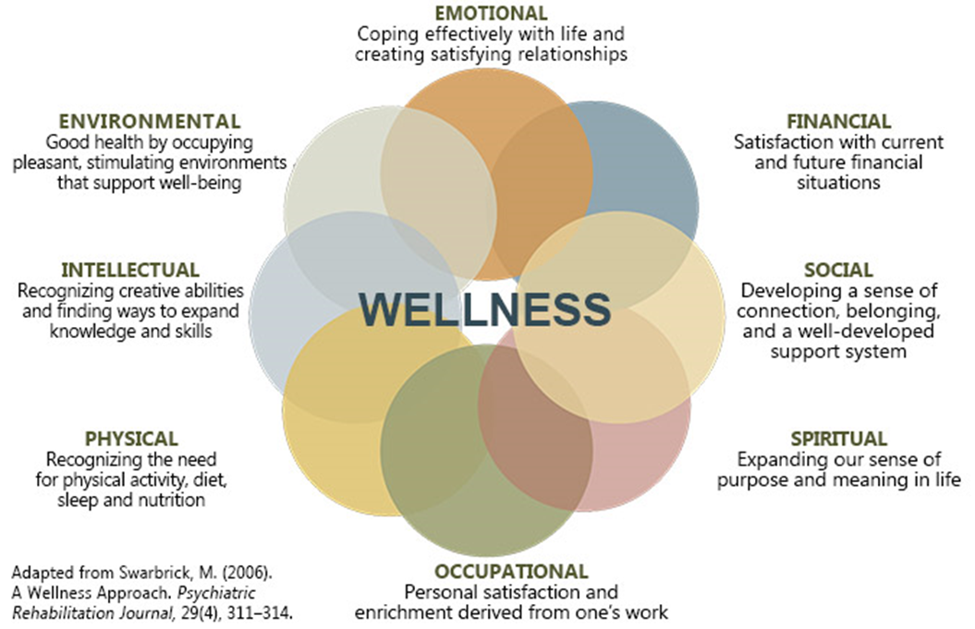
8 Dimensions of Wellness Framework

Slide 26
Priming the Organizational Culture
Culture of Wellness Assessment
-Self-Management Language and Messaging
-Organizational Wellness Committee
-Person-Centered Wellness Programing
Workforce Development
-Peer Recovery Support Specialist Continuing Education
-Wellness Coach Credential
Wellness Champion Network
-Community Connections and Resources
-Organizational Policies & Enforcement

Slide 27
Systems Change Timeline
Tobacco-Free Workplace Policy Requirement (FY12)
Peer Recovery Support Specialist Continuing Education Units
  Well Body, Tobacco-Free Support Group, Special Populations in Tobacco
Wellness Coaching Role Introduced (FY13)
Reimbursement opportunities expanded with Behavioral Health Home and Certified Community Behavioral Health Clinics (FY14)
Required state-funded behavioral health agencies to implement the “5 A’s” and refer consumers who use tobacco to the State Quitline (FY15)
Minimum 20% Cessation Referral Requirements for all contracting agencies (FY16)

Slide 28
Systems Change Timeline Continued
Tobacco-Free Workplace Policy Requirement Expansion (FY18)
Gap Nicotine Replacement Therapy (NRT) Project launch for residential, crisis and inpatient programs (FY19)
  FY19: 821 reached with a total budget of $18,060
Inpatient Psychiatric Hospital Cessation focus (FY20)
  FY20: 3,102 reached with a total budget of $62,604
  FY21: $100,000 budget dedicated to GAP NRT expansion
Inpatient Forensic Psychiatric Hospital Cessation focus (FY22)

Slide 29
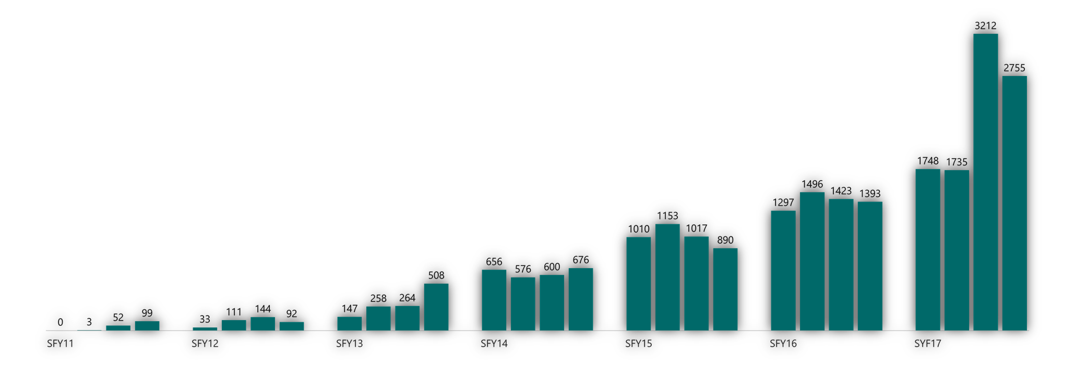
Oklahoma Tobacco Helpline Referrals

Slide 30
Outcome Overview
Oklahoma has the highest proportion of behavioral health treatment agencies in the U.S. that:
Offer cessation interventions
Refer to the State Quitline
Prescribe non-nicotine cessation medications
Provide tobacco-free campuses
Substance Use Mental Health
2012: 77% 71%
2013: 63% 59%
2014: 58% 54%
2015: 56% 49%
2016: 56% 48%
2017: 53% 46%
2018: 51% 45%

Slide 31



www.odmhsas.org
@ODMHSAS
@ODMHSASINFO

Slide 32

Re-Freeze TOB 3/3A
Education
Action
Acceptance phase
Use fully incorporated
Lock in change as SOP
Leadership voice essential
Review process effects for longevity and inclusion in any future process or technology upgrades
Reward, support champions
Monitor and publish change indicators
Reassess/ coach for staff competencies retention
Supervisors manage change fidelity
Orient new staff to this expected practice
Use NRI self-monitoring assessment tool to monitor TOB 3/3A outcome performance
Notes:
NRI Organizational Self-Monitoring tool by Lucille Schacht will be posted on the NRI Tobacco Cessation specialty page for Change Management

Slide 33
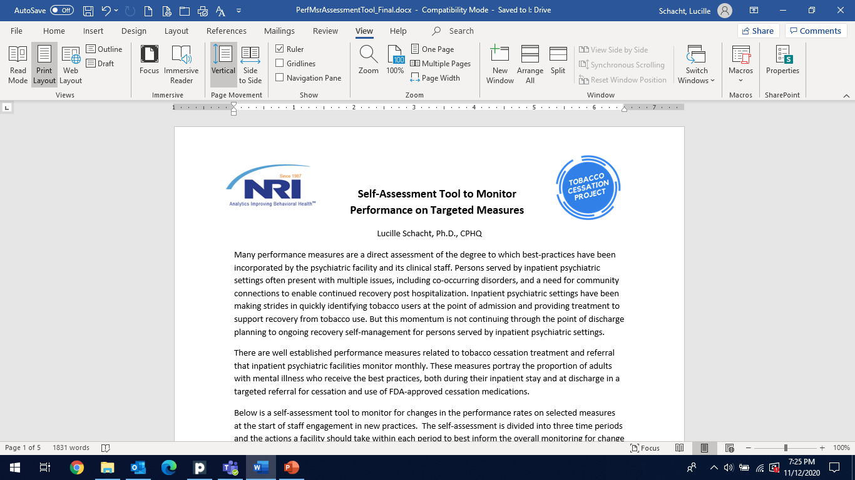
Monitoring a Change Process
The approach to the self-assessment is to highlight important questions a facility needs to ask itself about its current practice and the interventions it has undertaken.
The evaluation of the effectiveness of the intervention is described in the post-intervention period.

Slide 34
Pre-intervention
  Gather measure definition
  Gather existing control chart
  Outline the current practice for each measure (expected to be impacted by the intervention)
  Decision on change efforts
Intervention
  Policy level – organizational direction to staff and informing customers of operating standards
  Practice level – clinical actions that are changed and expectations
  Administrative level – support functions such as medical records and communications

Slide 35
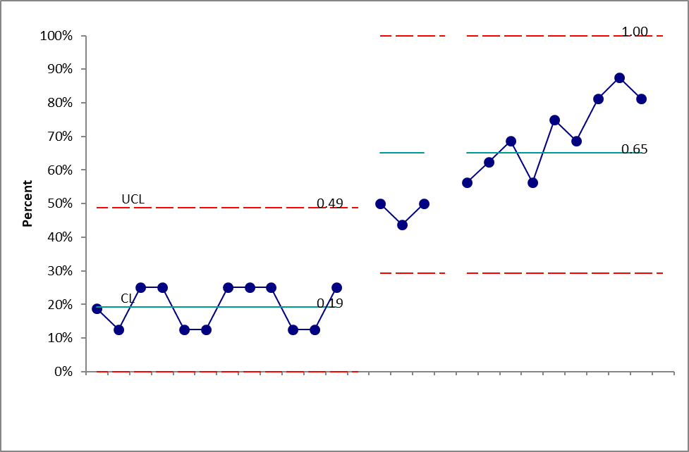
Post-intervention
  Control chart – expect to see statistical outliers, shifts and trends to indicate practice change
  Advanced analytics – comparisons across measures that are related
  Staff competencies – training, assessment of staff knowledge and skills
Notes:
Tie Pre-Intervention (Unfreeze) to Intervention (Change) Post intervention (Refreeze). Include post-analytics in paper. Staff competency evals for knowledge and skills

Slide 36
Notes:
Cochrane review: https://pubmed.ncbi.nlm.nih.gov/21069681/ Post intervention and analytics: becomes a success story others can build upon so important to be specific in pre-intervention what specific changes were made and what you did and how so others can test if that change will work in their environment. Missy to expand: There are EBP limitations for psychiatric hospitalized patients: Invitation to Collaborate to move the TOB 3 field forward. Shared learning about successes as well as failures is what moved the field forward.

Slide 37
Complete your Post-test
https://wh1.snapsurveys.com/s.asp?k=160562913766
Copy and paste into a new page
Notes:
Post test, infographics, slide deck and archive of presentations on NRI website

Slide 38
NRI Resources
https://www.nri-inc.org/focus-areas/performance- measurement/clinical-oversight/tobacco-cessation/
NRI staff
  Lucille.Schacht@nri-inc.org - Project Director
  Missy.Rand@nri-inc.org – Clinical Quality Educator
  Glorimar.Ortiz@nri-inc.org – Principal Biostatistician
  Torre.Boyd@nri-inc.org – Project Manager/HIPAA Compliance
  Alexis.Tyson@nri-inc.org – Quality Improvement Specialist
  Delia.Singleton@nri-inc.org – Quality Improvement Specialist
Kamal.Kohli@nri-inc.org - dot Net Developer

